Slide 1


Cloud computing
for education and research
Practice 01. Spring boot

Slide 2
Spring boot basic
01
Starter
Provide Dependencies to be Included in the Application
Provides auto configuration
spring-boot-starter-*
Spring boot is distributed in its own web container in Jar file format
Microservice should not share DB or web containers

Slide 3
Spring boot basic
01
main class
@SpringBootApplication = @Configuration, @EnableAutoConfiguration, @ComponentScan
spring-boot-starter-web include
@SpringBootApplication
public class Application {
public static void main(String[] args) {
SpringApplication.run(Application.class, args);
}
}

Slide 4
Spring boot basic
01
App build
You should provide the configuration responsible for incorporating all dependencies into a viable Jar (fat Jar) during the app's build
This is done by spring-boot-maven-plugin defined in pom.xml, which includes spring-core, spring-app, spring-context, spring boot, built-in tomcat, logback, Log4j, Slf4j, Jackson lib, etc
<plugin>
<groupId>org.springframework.boot</groupId>
<artifactId>spring-boot-maven-plugin</artifactId>
</plugin>

Slide 5
Spring boot basic
01
Customizing the configuration file
provide configuration information by application.yml
server:
port: ${port:2222}
spring:
application:
name: first-service
logging:
pattern:
console: "%d{HH:mm:ss.SSS} %-5level %logger{36} - %msg%n"
file: "%d{HH:mm:ss.SSS} [%thread] %-5level %logger{36} - %msg%n"
# level:
# org.springframework.web: DEBUG
file: app.log
management:
security:
enabled: false

Slide 6
Spring boot basic
01
Restful web service
The Jackson library, which serializes and de-serializes JSON messages, is included in the spring-boot-starter-web
Simply declare a model class
@RestController sets incoming HTTP requests to a controller empty class
@RequestMapping: used to correspond to the controller method and HTTP
@GetMapping, @PostMapping, @DeleteMapping = @RequestMapping(method=RequestMethod.GET) ..
@RequestParam: Bind the path and input value of the request to object
@RequestBody: Bind input JSON to Object using Jackson Library

Slide 7
Spring boot basic
01
API documetation
Swagger is used the most
Springfox-swagger2, springfox-swagger-ui must be added to the dependency
Automatically create API documents by swagger when the app is launched
@Bean
public Docket api() throws IOException, XmlPullParserException {
MavenXpp3Reader reader = new MavenXpp3Reader();
Model model = reader.read(new FileReader("pom.xml"));
ApiInfoBuilder builder = new ApiInfoBuilder()
.title("Person Service Api Documentation")
.description("Documentation automatically generated")
.version(model.getVersion())
.contact(new Contact(“youngkon", “yklee.wordpress.com", “yklee2002@gmail.com"));
return new Docket(DocumentationType.SWAGGER_2).select()
.apis(RequestHandlerSelectors.basePackage("pl.piomin.services.boot.controller"))
.paths(PathSelectors.any()).build()
.apiInfo(builder.build());
}

Slide 8
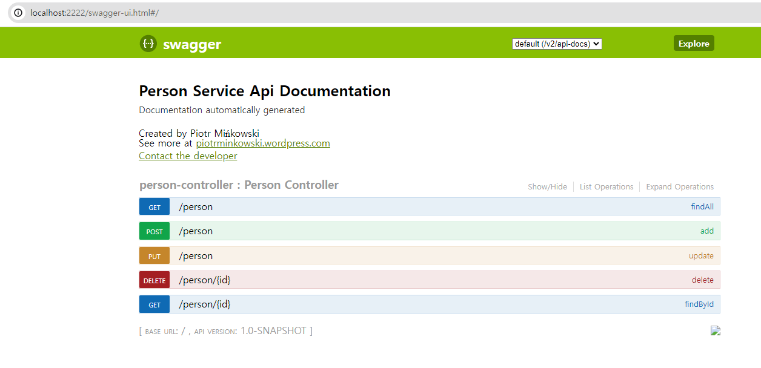
Spring boot basic
Swagger
01

Slide 9
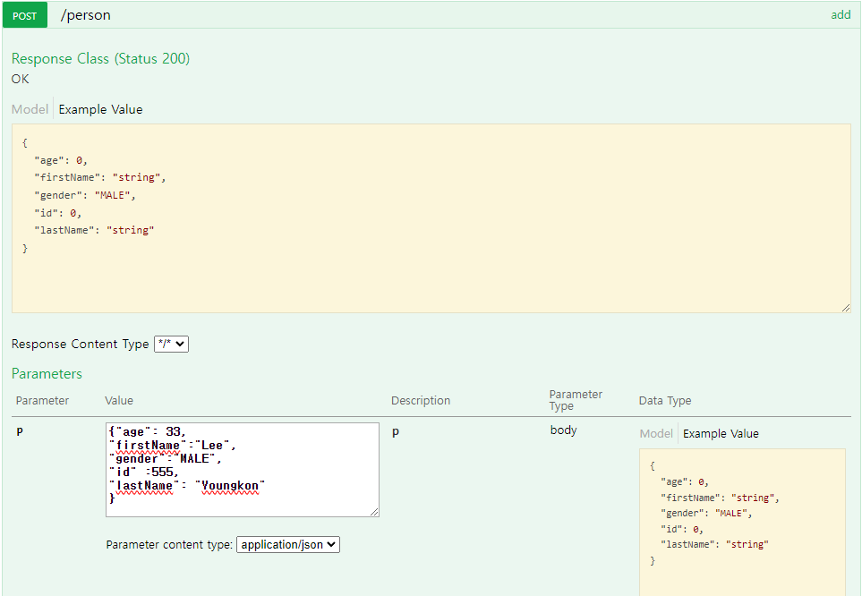
Spring boot basic
Swagger
01

Slide 10
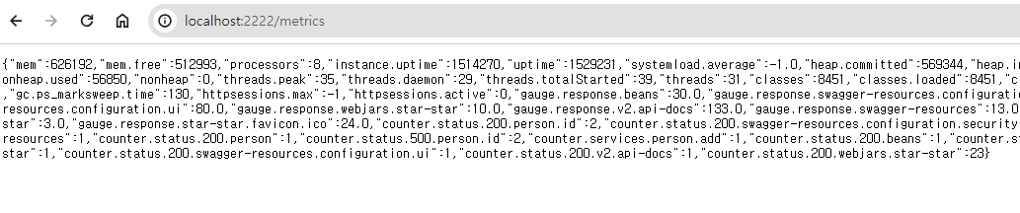
Spring boot basic
01
Spring boot Actuator
Provides endpoint for monitoring and interacting with apps
/beans: Display a list of all spring bins initialized in the app
/env: Displays a list of spring's configurable environmental properties
/health:displaying app status information
/info: Show arbitrary information in the app
/loggers: Displays logger configuration information for the app
/metrics: Display the app's metric information (memory, thread, rest response time, etc.)
/trace:displaying trace information
To disable security in a project, manage in the application.yml file,
add security.enabled: false

Slide 11
Spring boot basic
01
Developer Tools
Restart automatically if files on the class path change
spring-boot-devtools dependency is included
To avoid restarting changes, include them in the exclusion
<dependency>
<groupId>org.springframework.boot</groupId>
<artifactId>spring-boot-devtools</artifactId>
<optional>true</optional>
</dependency>
spring:
application:
name: first-service
devtools:
restart:
exclude: static/**

Slide 12
Spring boot basic
01
Developer Tools
Spring cloud fetches the configuration from a remote server. For this, the minimum settings required in the app must be set in the bootstrap context, that is, the app name and configuration address setting. In other words, so that the configuration can be read from an external source.
Bootstrap context uses bootstrap.yml
To disable bootstrap, set spring.cloud.bootstrap.enabled to false
The bootstrap configuration file name can be changed at spring.cloud.bootstrap.name .Change location to location
spring:
application:
name: first-service
cloud:
config:
uri: http://192.168.99.100:8888

Slide 13
JPA
02
Entity
Entity refers to an object that is mapped to a DB table.
Entity Manager
Manage entities to create, modify, and delete objects between DB and App
The entity manager factory is where you create the entity manager
Create and manage only one entity manager factory inside the spring boot and use the entity manager using @PerformanceContext or @Autowired

Slide 14
JPA
02
Persistent Context
The entity manager stores the entity in a persistent context
A persistence context is a virtual space that manages an entity
Primary cache, write delay, change detection, delay loading feature
First Cache
The key of the cache is the identifier with the entity's @Id and the value is the entity
When inquiring an entity, it is queried in the primary cache and returned if there is a value; if not, it is read from the DB, stored in the cache, and returned

Slide 15
JPA
02
write delay
Gather queries without sending a query to the DB until committing a transaction, and run the query at once upon commitment
change detection
When committing a transaction, compare the value of the entity stored in the primary cache with the value of the current entity and detect any changes and automatically reflect them in the DB

Slide 16
JPA
02
Defered Loading
Querying means querying data by sending queries when needed, rather than loading the data requested by the query directly into the app
Summary
To increase performance by minimizing DB access

Slide 17
Spring Data
02
Spring Data
Abstract DB usage at class level to focus on business logic
Use spring data through the interface provided by spring data
Spring Data JPA
Adding useful technology from JPA in common functionality of spring data
Create an interface that acts as a repository to easily query, modify, create, and delete DB tables
@Repository
public interface BookRepository extends CrudRepository<Book, Integer> {
}

Slide 18
Spring Data
Spring Data JPA
@Service
public class BookService {
@Autowired
BookRepository bookRepository;
public void test() {
bookRepository.save(new Book(5, "my book","yklee", new java.util.Date()));
List<Book> bookList = (List<Book>) bookRepository.findAll();
bookRepository.deleteById(5);
}
}
02

Slide 19
Spring Data
@Entity
@Getter
@NoArgsConstructor(access= AccessLevel.PROTECTED)
@AllArgsConstructor
public class Book {
@Id
@GeneratedValue(strategy = GenerationType.IDENTITY)
@Column(name = "id", updatable= false)
private long id;
@Column(name = "name", nullable = false)
private String name;
@Column(name = "author")
private String author;
@CreationTimestamp
@Column(name = "published", columnDefinition =
"TIMESTAMP DEFAULT CURRENT_TIMESTAMP", updatable = false)
@Temporal(TemporalType.TIMESTAMP)
private Date published;
}
Entity Sample Code
02

Slide 20
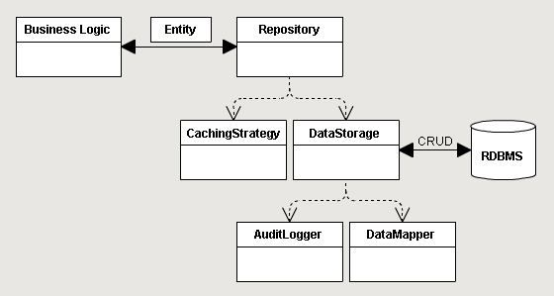
Spring data
02
Entity sample

Slide 21
JPA
Example
@Document(collection = "person")
public class Person {
@Id
private String id;
private String firstName;
private String lastName;
private int age;
private String gender;
public interface PersonRepository extends MongoRepository<Person, String> {
public List<Person> findByLastName(String lastName);
public List<Person> findByAgeGreaterThan(int age);
}
01

Slide 22
JPA
Example
spring:
profiles: production
application:
name: first-service
data:
mongodb:
#host: 192.168.99.100
host: localhsot
port: 27017
database: microservice
#username: micro
#password: micro
autoconfigure:
exclude: org.springframework.boot.autoconfigure.mongo.embedded.EmbeddedMongoAutoConfiguration
01

Slide 23
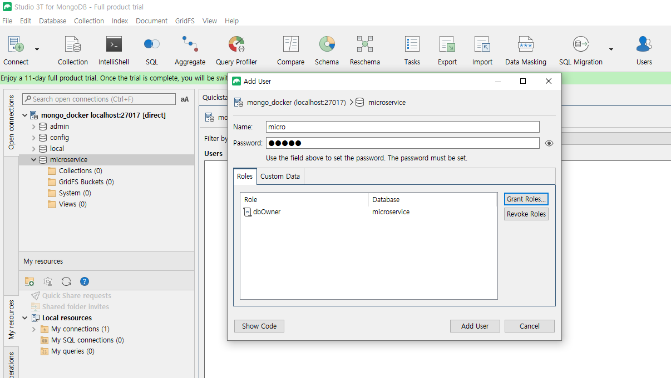
JPA
docker run -d --name mongo -p 27017:27017 mongo:4.4
Example
01

Slide 24
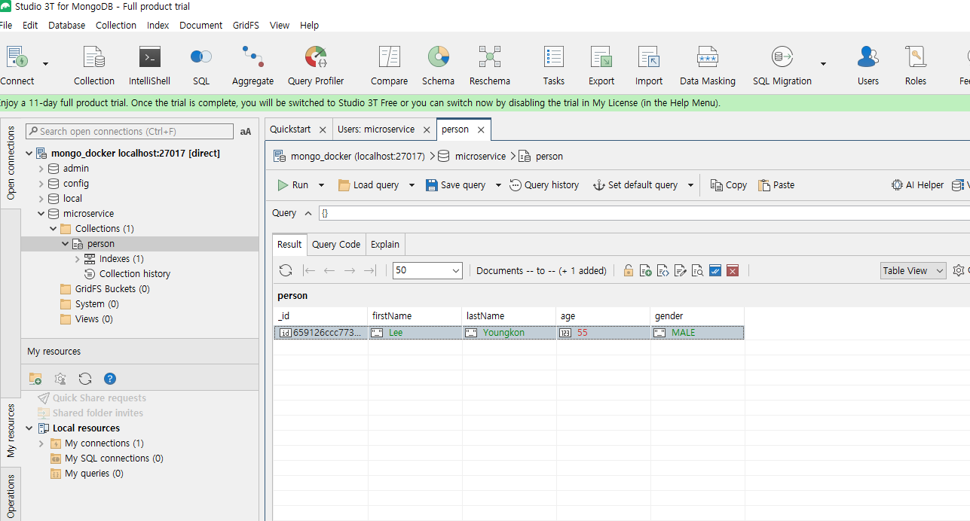
JPA
Example
01

Slide 25
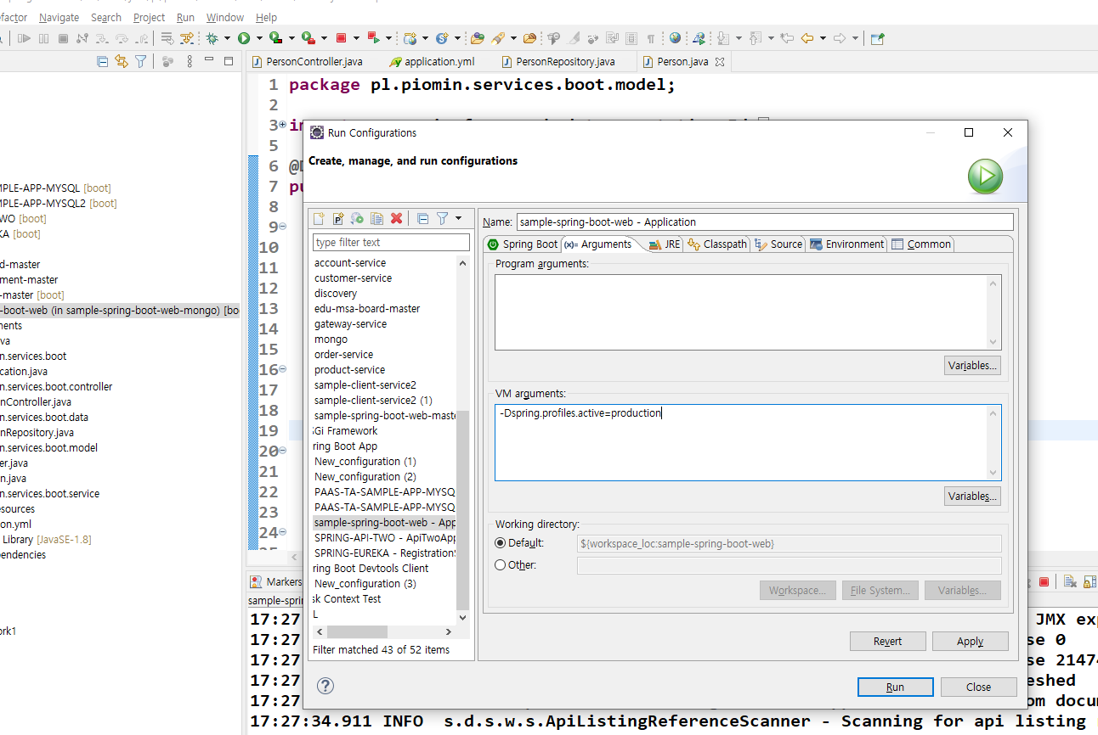
JPA
Example
01

Slide 26
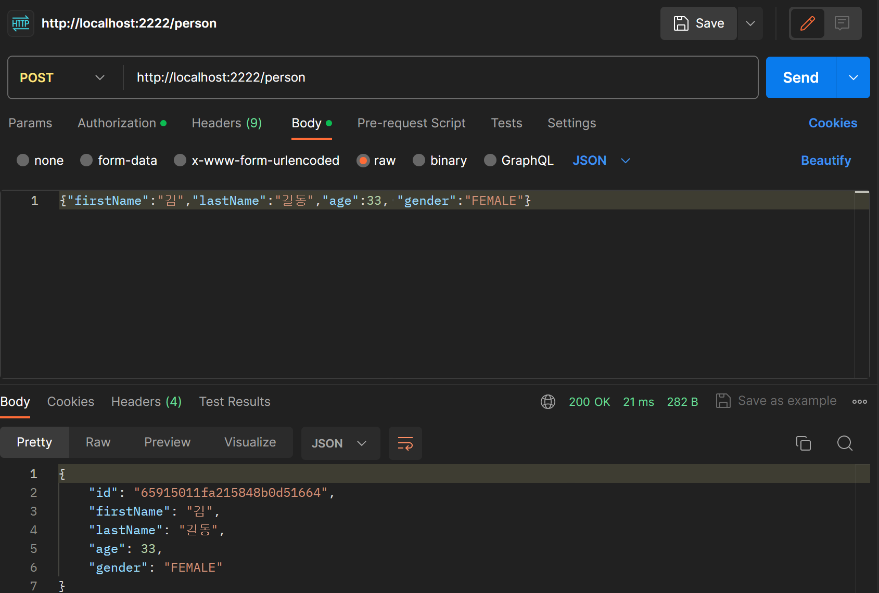
JPA
Example
01

Slide 27
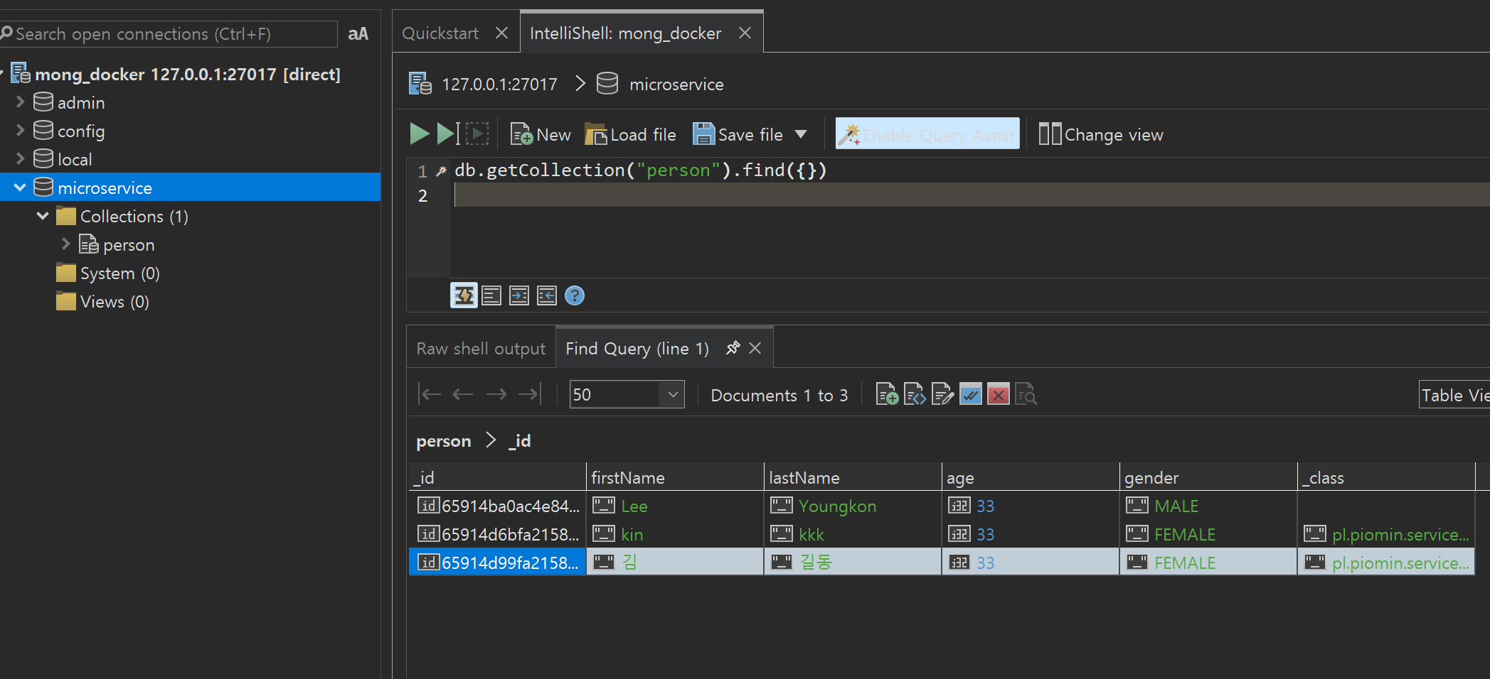
JPA
Example
01

